Slide 1
Instagram Clone App

Slide 2
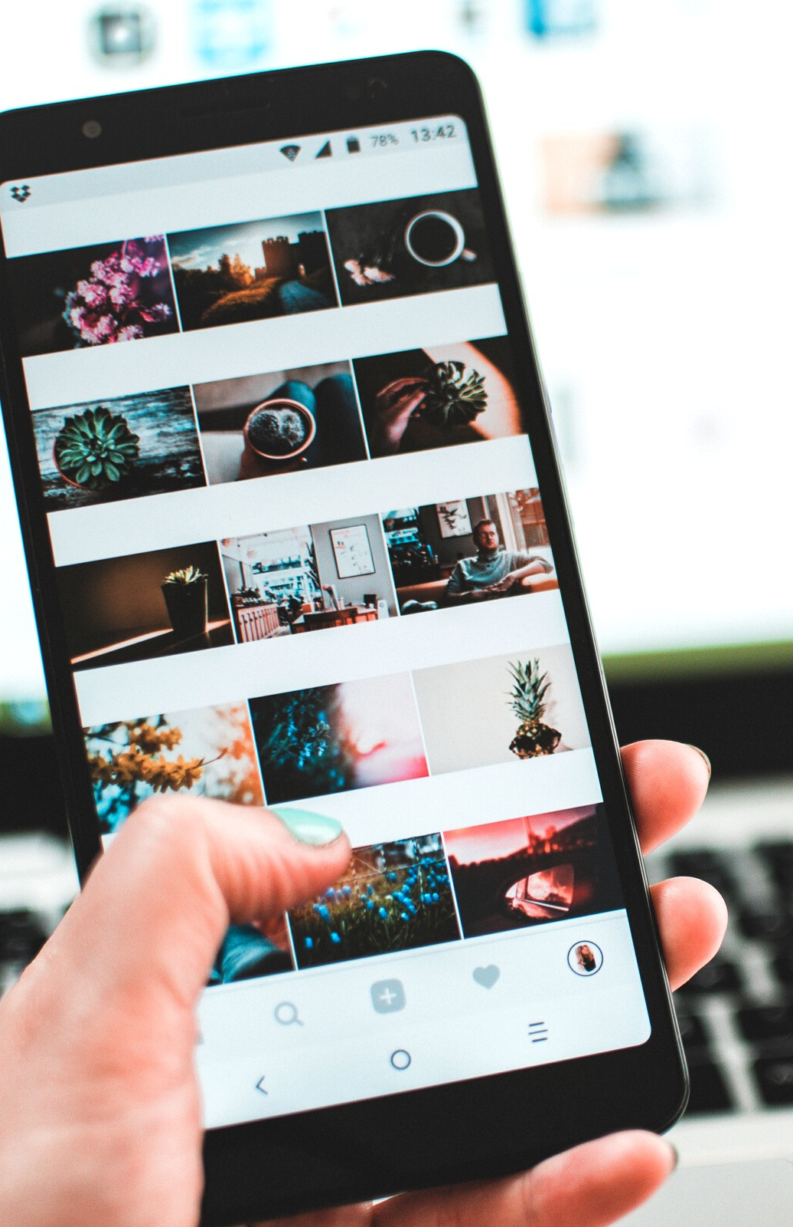
The No. 1 Instagram Clone Script
W I T H C U T T I N G - E D G E F E A T U R E S E T
Instagram clone is a white-label social media solution
that is readily available for customization and launch. It is an excellent option for businesses looking to foray
into the social media app market in the near future.
Our solution is pre-packed with all features and functionality, similar to the Instagram app.

Slide 3
Key Features
O F O U R I N S T A G R A M C L O N E S O L U T I O N
HOME SCREEN
SEARCH MODULE
UPLOAD MEDIA
ACTIVITY LOG
DETAILED PROFILE

Slide 4

Monetization Strategies Included
Sponsored Posts- Let users or businesses promote their posts to reach more numbers, especially users who do not follow their profiles. It helps them increase their visibility, build post engagement, and gain more followers.
Carousel Advertising- Similar to sponsored posts, carousel ads help in promoting posts. The only difference is that it allows the advertising of multiple images in a single post.
In-App Purchases- Enable users to access
custom filters and effects for a price. Also, there are a lot of special elements in Instagram like an app
that you can allow users to avail for a certain fee.

Slide 5

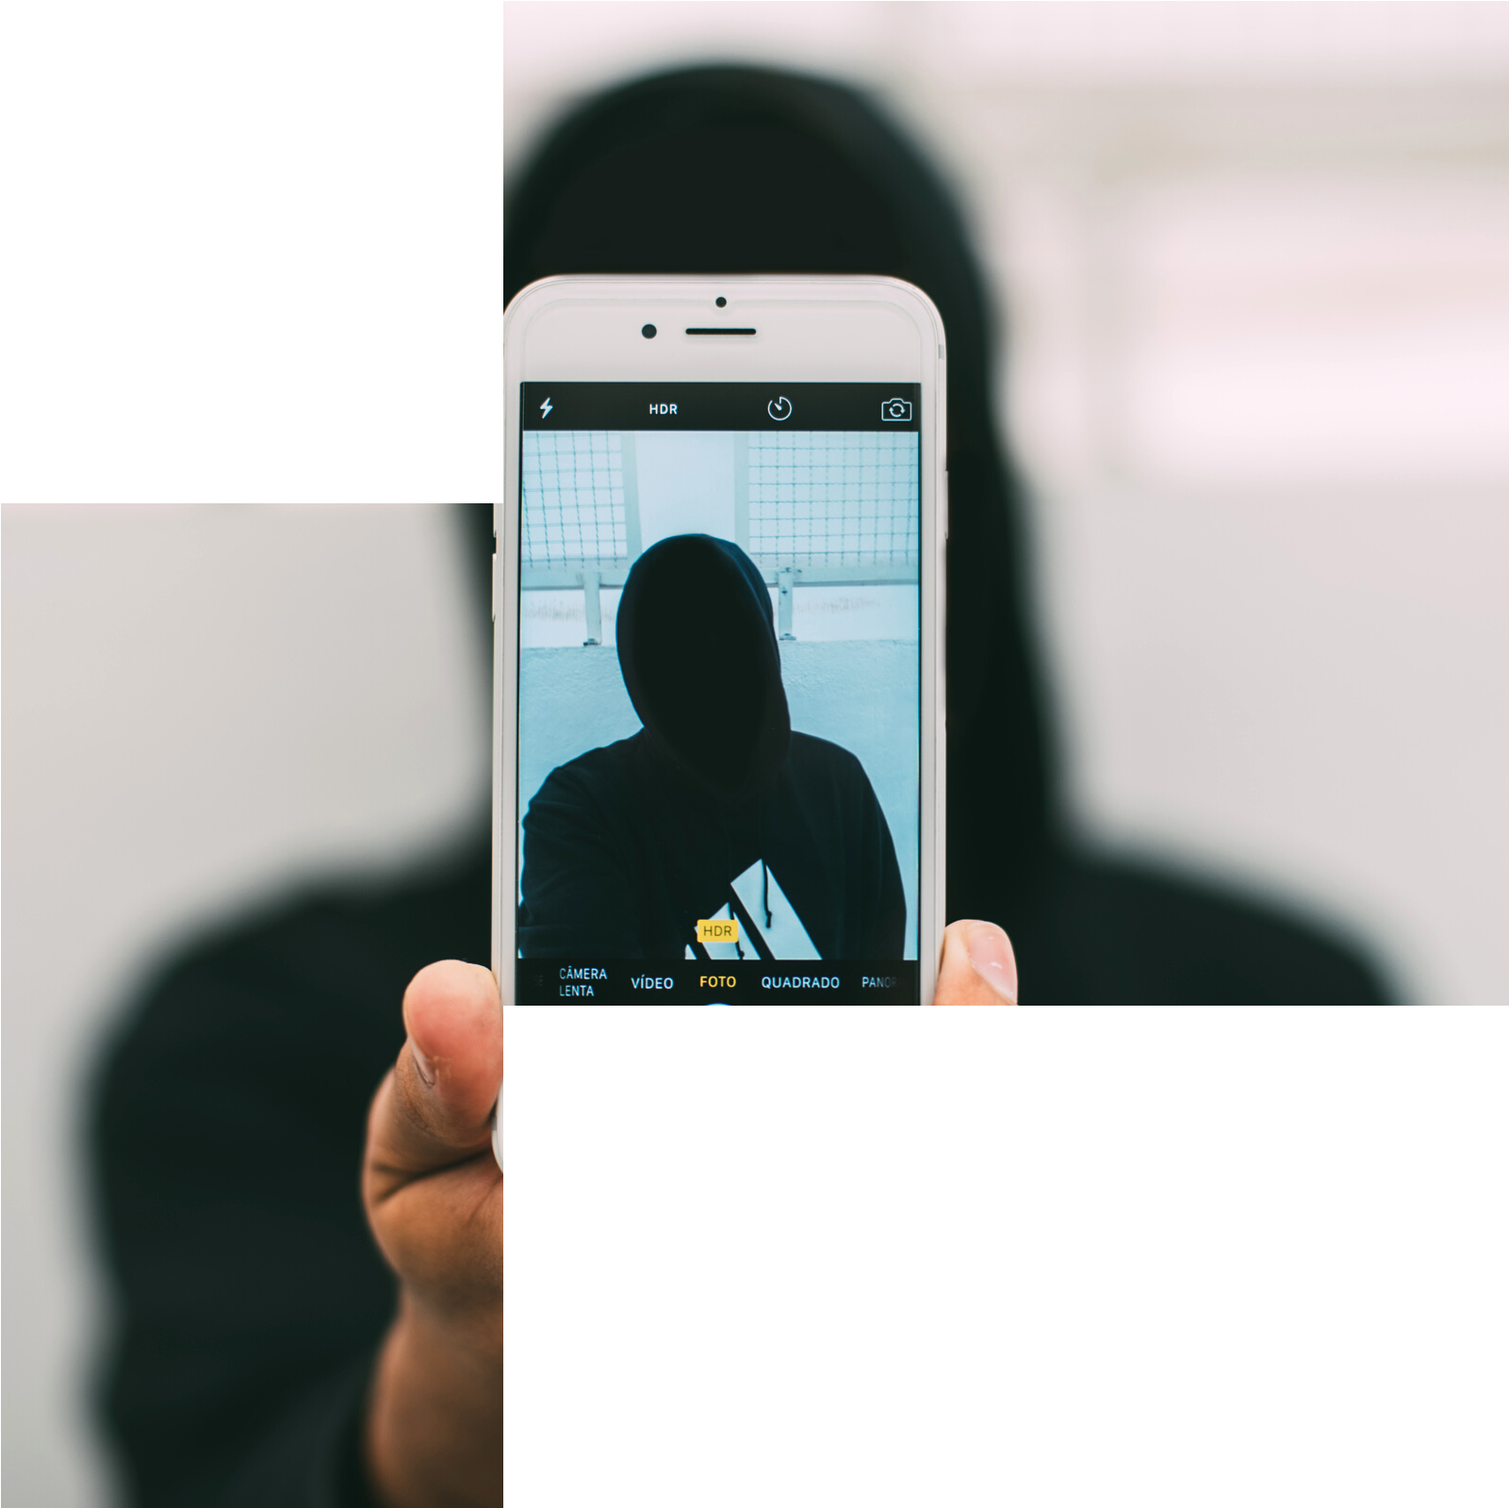
Solution We Offer
Turnkey Solution- All our products are ‘Turnkey’. You can start with ZERO time-to-market, capture the largest market share and become the leader everybody else plays catch up with.
Powerful Admin Dashboard- Complete control of your websites and mobile apps is comfortably available in your admin dashboard. You
can push messages to your apps and everything.
Scalable Product- Have plans of taking off and scaling up rapidly?
We got your back with the most scalable robust products in each category.

Slide 6
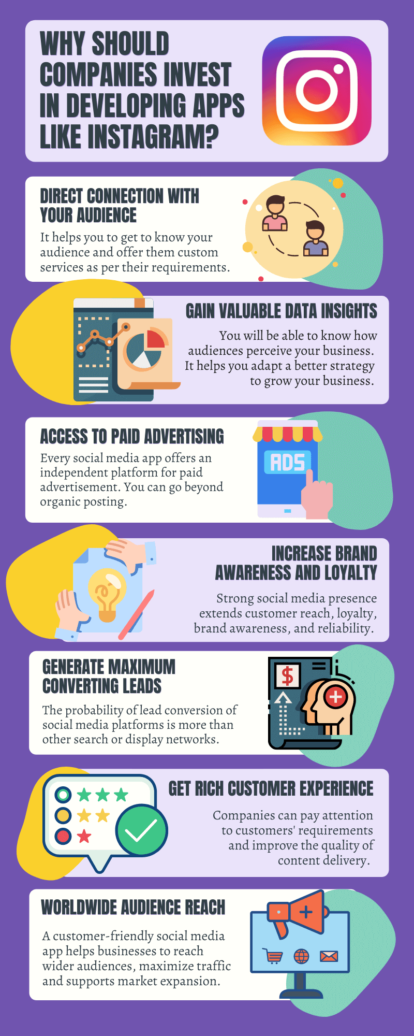
How to Create an App Like Instagram Successfully?
• Conduct market research to know your audience and their preferences.Divide
your search criteria into three parts
• What makes users stick to one application?
• What are the additional features and services offered by competitor
applications?
• Your target audience, their likes, and dislikes and what market gap your product
needs to fill up?
• Evaluate competitive social media apps
• Conceptualize your unique and outstanding app concept
• Define your project strategy and estimate certain things like budget, deadline,
goals, and technologies.
Make your promotional strategy and promote your app to create brand
awareness.
• Build communication to get in touch with your audience and get their feedback.
Getting user’s feedback will help you to know the loopholes.
• Hire a mobile app development company equipped with experienced app
development professionals. It will help you to design, develop and test your
product in a better way.

Slide 7
What tech stacks are used in Instagram-like app development?
Instagram is based on a wide array of technologies. You can also use some of them for
your next project. Instagram is fully functional on both Android and iOS operating
systems. For back-end development, Instagram relies on the Django framework and
HTML5. For your reference, the entire tech-stack of an app like Instagram is listed
below.
JavaScript UI Library
• React
Cross-platform
• React Native
Language
• Python
• JavaScript
• Java
• Objective-C
Framework
• Node.JS

Slide 8
Database
• MongoDB
• Web Servers(Node.JS)
• JS Utility & Library
• Immutable.js
DevOps
• JS Build Tool
• Webpack
• JavaScript Compiler
• Babel
• Load Balancer
• Event listener & Hooks
• Server Configuration & Automation
• IDE
• Nuclide
• Geolocation (IP Tracking)

Slide 9
Basic functionalities
Authorization
This feature enables users to register themselves using their email ID, mobile number,
or also via social media login. After the successful registration, he/she can get the
inside view and benefits of the app.
Editing profile
• Editing personal data
• Removing personal data
• Adding personal data
Post creation
• Upload picture from phone gallery
• Take a new picture from the app
• Add tags and mention other friends in the posts
Feed
• Subscribing (one-way following)
• Liking
• Commenting

Slide 10
Standard options for image customization like
• Cropping
• Rotating
• Image adjustments
• Applying filters
Geolocation features
• Identify the existing or current location of the user and add it to the post
Messaging
• Text and photo messaging
Notifications
• Push notifications to notify users about the new messages and other activities
on the app
Search option
• By username or full name
• By hashtags
• By places

Slide 11
Final Words!
When Instagram was first introduced it supported a basic filter and image sharing features. With the passing years and users’ demand, it introduces multiple features and functionalities that we had already discussed above. Today, a single app is capable of performing multiple jobs and creating a buzz over the internet. It won’t be wrong to state that Instagram has become a hub of social influencers, marketers, and notable brands. Many businesses are inspired by Instagram and find it a money-making opportunity to invest in developing an app like Instagram. But the biggest question is “What All It Takes To Build An App Like Instagram?” Well building an app like Instagram is not an impossible task but not an easy one too. It takes a great combination of the right project strategy, mobile app development skills, and an experienced team of professionals who can build technically sound products. Sparx IT Solutions is the one-stop destination for social media mobile app development services that bring the best outcomes. We help businesses to grow faster by delivering modern app solutions.

Slide 12
Talk to Us
G A GA NDE E P S I N GH
M E R N ST A C K D E V E L O PE R
/l i n k d i n/g a g an d e e p -s i n g h
T U S H A R
M E R N ST A C K D E V E LO P E R
/l i n k d i n/ t u s h a r -t e j a n
R I S H A B S H A R M A
F R O N T- E N D D E V E LO P E R
/l i n k d i n/r i s h a b- s h a r ma
LET' S BRAINSTORM

